Slide 1
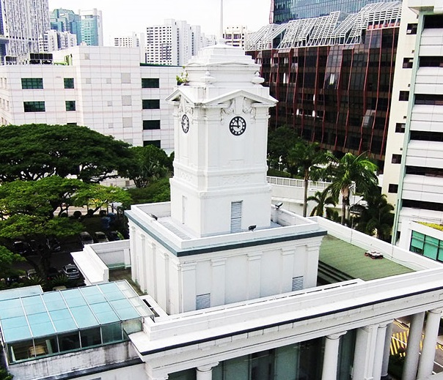
Meta-Analysis Comparing the Femoral Tunnel Length, Femoral Tunnel Position and Graft Bending Angle of Transtibial, Anteromedial and Outside-In Techniques for Single-Bundle Anterior Cruciate Ligament Reconstruction
Yeo Zhen Ning, Andrew Arjun Sayampanathan, Andrew Tan Hwee Chye

Slide 2
Introduction
History
Femoral Tunnel Drilling techniques in Anterior Cruciate Ligament (ACL) reconstructions
Transtibial (TT) Technique
Anteromedial (AM) Technique
Outside-in (OI) Technique
Parameters for assessment of femoral tunnel geometry
Femoral Tunnel Position | Anatomic positioning of femoral tunnels contribute to better knee kinematics and stability compared to non-anatomically positioned femoral tunnels [1]
Femoral Tunnel Length | Park et al [2]. suggested that the tunnel length should be no shorter than 25mm to allow sufficient graft length, to provide sufficient pull-out strength and tendon-bone tunnel healing
Graft Bending Angles | Graft Bending Angle (GBA) is the angle between the femoral tunnel and the line connecting the femoral and tibial tunnel apertures [3]. Cadaveric studies have revealed that an ACL graft which is bent acutely at the femoral tunnel apertures may cause excessive stress on the bone-graft interface due to abrasion and repetitive bending [4,5]

Slide 3
Introduction
History
Objective
This study aims to analyse clinical studies comparing femoral tunnel position (FTP), femoral tunnel length (FTL) and graft bending angle (GBA) of single-bundle Anterior Cruciate Ligament (ACL) reconstruction using Transtibial (TT), Anteromedial (AM) and Outside-in (OI) techniques
Hypothesis
Independent drilling methods such as anteromedial and outside-in approach will provide a more anatomical position.
Transtibial technique will be longer due to the nature of technique
Lastly with regards to graft bending angle, due to the wide range reported outcomes, we hypothesise that there will not be any differences comparing all three techniques.

Slide 4
Method
History
Eligibility Criteria
 | Inclusion criteria | Exclusion criteria
Population | Adult (≥ 18 years) human patients undergoing arthroscopic ACL reconstruction | Animal or cadaveric studies
Intervention | Single-bundle arthroscopic ACL reconstruction surgery Comparison of AM vs TT techniques of surgery Comparison of OI vs TT techniques of surgery Comparison of OI vs AM techniques of surgery Comparison of OI vs AM vs TT techniques of surgery | ACL reconstructions which were not single-bundle ACL reconstructions which were performed not using the traditionally described transtibial, anteromedial and/or outside-in techniques
Outcomes | Analysis and full reporting tunnel length in coronal plane Analysis and full reporting tunnel obliquity in coronal and sagittal plane Analysis and full reporting graft bending angle in coronal plane Analysis and full reporting of tunnel position using the quadrant method Parameters were reported including means, standard deviation and sample numbers | Laboratory outcomes Studies that does not measure tunnel length, tunnel obliquity, graft bending angle, tunnel position Studies that does not measure tunnel position using quadrant method Studies that does not utilize CT for imaging
Study Design | Prospective randomised controlled clinical trials Retrospective comparison studies | Poor quality studies (including RCTs of poor quality and others with low level of evidence) Commentaries and controlled laboratory studies

Slide 5
Method
History
Fig. 1 PRISMA flow-chart summarising article selection

Slide 6
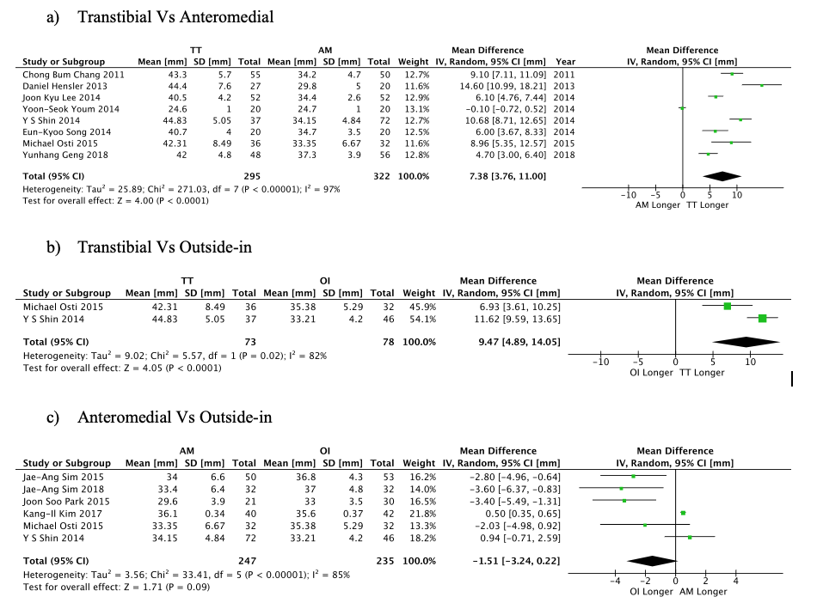
Results
History
Tunnel Length
TT technique had a longer femoral tunnel length compared to AM Technique
The mean differences ranges between 4.70 to 14.60 with only 1 study (Yoon-Seouk Youm 2014) reporting longer femoral tunnel length in AM technique. When compared to the OI technique, the TT technique was also shown to have a longer femoral tunnel length.
The mean differences ranges between 6.93 to 11.62. However, there was no significant difference in femoral tunnel length when the AM and OI techniques were compared. This is illustrated by a diverse range in mean differences ranges between -3.60 to 0.94.

Slide 7
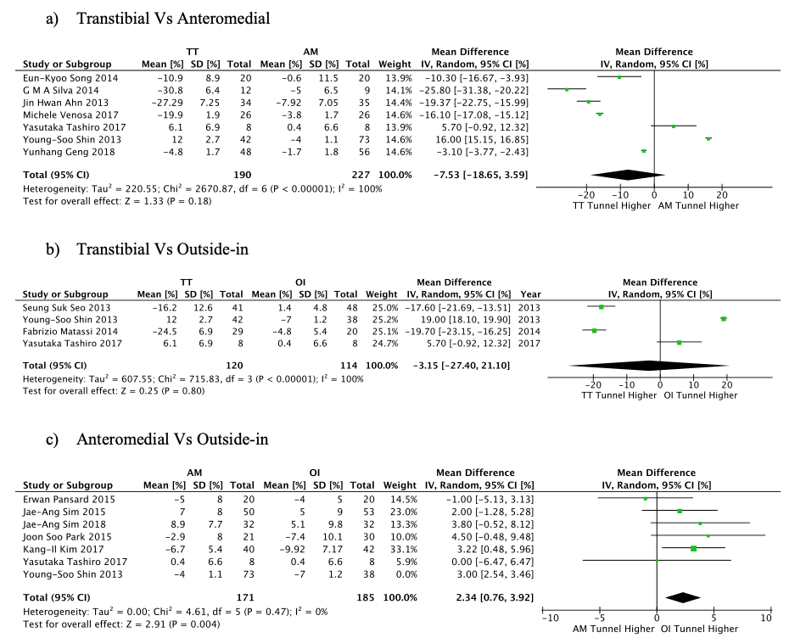
Results
History
Tunnel Position (high-to-low)
In terms of tunnel position in the high-to-low direction (h%), the OI technique resulted in a higher tunnel position as compared to the AM technique.
The mean difference in anatomic position and recorded position in AM technique ranges between -7.92 to 8.90, whereas in the OI technique the mean difference ranges between -9.92 to 5.1.
There were minimal differences in the high-to-low direction of femoral tunnels when comparing the TT and AM techniques and the TT and OI techniques.
Therefore, the AM technique resulted in a significantly closer anatomic placement of the femoral tunnel in the high-to-low direction when compared to the OI technique.

Slide 8
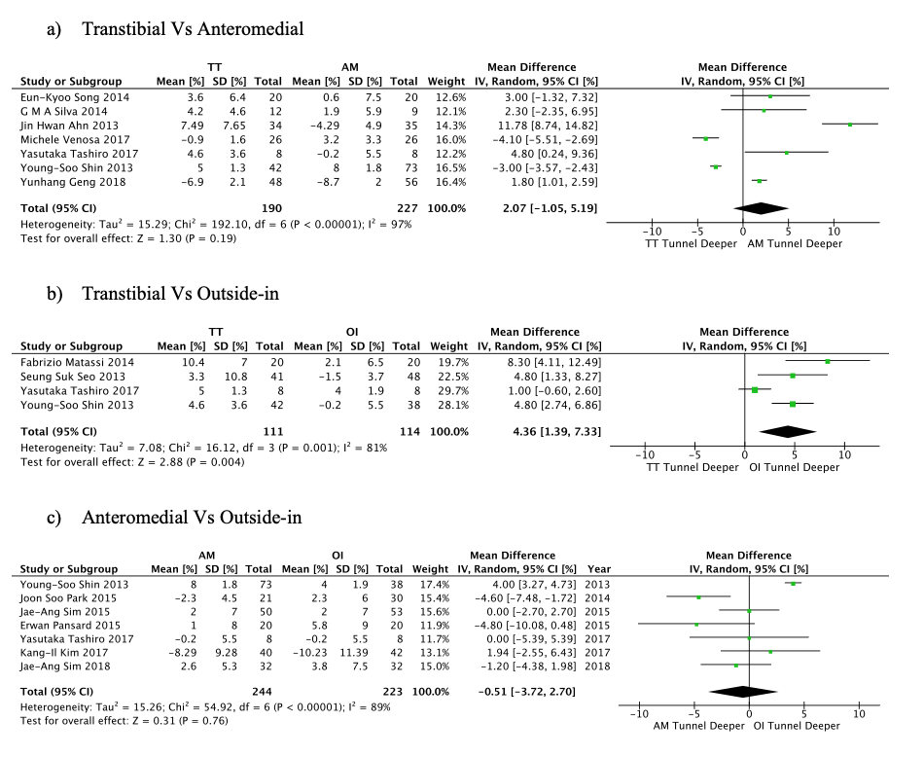
Results
History
Tunnel Position (Deep-to-shallow)
In terms of tunnel position in the deep-to-shallow direction, the OI technique resulted in a deeper tunnel position when compared to the TT technique
The mean difference in anatomic position and recorded position in AM technique ranges between -8.7 to 8, whereas in the OI technique the mean difference ranges between -10.23 to 5.8.
There were no significant differences in the deep-to-shallow direction of the tunnel position when comparing the TT and AM techniques as well as the AM and OI techniques.
Therefore, the OI technique resulted in a significantly closer anatomic placement of the femoral tunnel in the deep-to-shallow direction when compared to the TT technique.

Slide 9
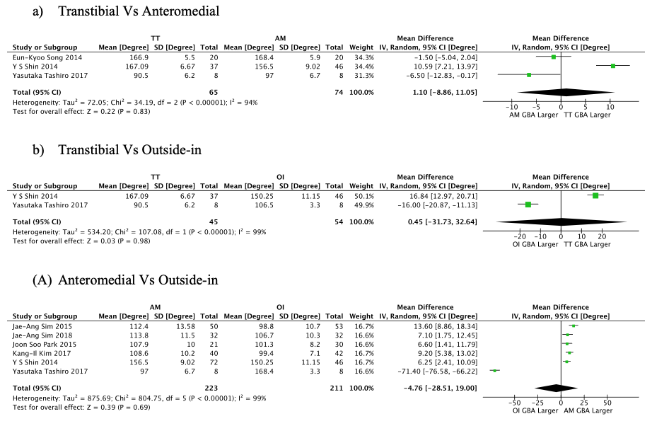
Results
History
Graft Bending Angle
There were no significant differences in the graft bending angle when comparing the TT, AM and OI techniques
The mean differences range between -6.50 to 10.5. TT and OI techniques, the mean differences range between -16.00 to 16.84. AM and OI techniques, the mean differences range between -71.40 to 13.60.

Slide 10
Conclusions
History
The independent drilling (anteromedial and outside-in) techniques provide a more anatomical position as compared to the transtibial technique.
Although femoral tunnel length in the transtibial technique is longer than the independent drilling technique, it should not be of concern as they usually exceed the critical length of 25mm.
There are no differences in the graft bending angle between the three techniques compared in this review.

Slide 11
Discussions
History
Femoral Tunnel Position
There was a significant difference in femoral tunnel positions between the TT and OI groups in the deep-to-shallow direction with the OI technique allowing for more anatomical positioning of the ACL graft.
This finding is consistent with the current literature which explains that the TT technique tends to produce non-anatomical placement mainly due to the constraints of the technique, such as the position of the femoral tunnel being pre-determined by the tibial tunnel position [6-7]
The OI technique, on the other hand, provides more freedom in angulation of the femoral guide [8] This allows for a higher success rate of anatomical placement [9].

Slide 12
Discussions
History
Femoral Tunnel Length
The analysis demonstrated that the TT technique had the longest femoral tunnel length.
The findings were consistent with the findings by Lee et al24 which included controlled cadaveric studies.
However, this finding may not be a significant clinical issue as the majority of studies (16 of 17 studies) reported adequate femoral tunnel lengths for all ACL reconstruction techniques (>25mm). Only Youm et al (2014) reported an average femoral tunnel length of 24.7mm for patients who underwent ACL reconstruction via the AM technique at their centre.
There are reports [10,11] that claim that critically short femoral tunnel (less than 25mm) can result in issue such as graft tunnel-mismatch and inadequate amount of graft in tunnel at time of construction.
In general, since the femoral tunnel length remains adequate regardless of the ACL reconstruction technique being utilised, the AM and OI techniques remain able to provide sufficient pull-out strength and tendon-bone healing despite resulting in slightly shorter femoral tunnel lengths compared to the TT technique.

Slide 13
Discussions
History
Femoral Tunnel Length
Specific to graft bending angles, literature has shown that higher GBAs can lead to poorer proximal graft healing, hence contributing to a higher chance of graft failure [12].
Steep GBAs have been associated with friction, graft stretch and fatigue failure [13].
There have been many analyses including Nishimoto et al. [14] on double-bundle reconstructions highlighting that the TT technique contributes to a more acute GBA than the AM technique. Niki et al [15] also revealed that the OI technique resulted in a more acute GBA as compared to the AM technique.
This study, however, showed that the differences in GBA amongst the techniques were insignificant.

Slide 14
Limitations
History
Firstly, a significant number of studies included were non-randomised and retrospective in nature. Ideally all studies should be randomised controlled trials to obtain the highest quality.
Regardless, there were measures taken to ensure the quality of the review was maintained. These included the exclusion of cadaveric studies and ensuring the papers included measured outcomes using high-quality imaging modality CT scan.
Secondly, the mixture of studies, alongside with differences in patient co-morbidities and demographics, may have resulted in biases and heterogeneity in our study.
To cope with these limitations, a random-effect model is implemented in light of the heterogeneity that may be present in these studies.
All these might have contributed to errors in pooled analysis, therefore pooled mean differences has been intentionally avoided in this study. Data and forest plots have been presented with the reporting of ranges.
One way to reduce such differences would have been to tighten the inclusion criteria and only include studies which carried out a triple-group analysis.
There was, however, insufficient literature available on triple-group analyses. Of the 17 studies that were included, 4 performed a triple-group analysis, of which only 2 measured tunnel position, 2 measured tunnel length and 2 measured GBA.

Slide 15
References
Physical
References
Musahl V, Plakseychuk A, Vanscyoc A, Sasaki T, Debski RE, Mcmahon PJ, et al. Varying femoral tunnels between the anatomical footprint and isometric positions: effect on kinematics of the anterior cruciate ligament-reconstructed knee. Am J Sports Med 2005;33.5: 712-718.
Park JS, Park JH, Wang JH, Oh CH, Hwang MH, Lee SH, et al. Comparison of femoral tunnel geometry, using in vivo 3-dimensional computed tomography, during transportal and outside-in single-bundle anterior cruciate ligament reconstruction techniques. Arthroscopy 2015;31.1:83-91.
Nishimoto K, Kuroda R, Mizuno K, Hoshino Y, Nagamune K, Kubo S, et al. Analysis of the graft bending angle at the femoral tunnel aperture in anatomic double bundle anterior cruciate ligament reconstruction: a comparison of the transtibial and the far anteromedial portal technique. Knee Surg Sports Traumatol Arthrosc 2009;17.3:270-276.
Natsu-Ume T, Shino K, Nakata K, Nakamura N, Toritsuka Y, Mae T. Endoscopic reconstruction of the anterior cruciate ligament with quadrupled hamstring tendons: a correlation between MRI changes and restored stability of the knee. J Bone Joint Surg Br 2001;83.6:834-837.
Segawa H, Omori G, Tomita S, Koga Y. Bone tunnel enlargement after anterior cruciate ligament reconstruction using hamstring tendons. Knee Surg Sports Traumatol Arthrosc 2001;9.4:206-210.
Nakamura T, Koga H, Otabe K, Horie M, Watanabe T, Yagishita K, et al. Comparison of three approaches for femoral tunnel during double-bundle anterior cruciate ligament reconstruction: A case controlled study. Journal of Orthopaedic Science 2019;24.1 :147-152.
Cuomo P, Rama KR, Bull AM, Amis AA. The effects of different tensioning strategies on knee laxity and graft tension after double-bundle anterior cruciate ligament reconstruction. Am J Sports Med. 2007;35.12:2083–2090
Sinha S, Naik AK, Meena D, Jain VK, Arya RK. Creation of femoral tunnel by outside-in technique for ACL reconstruction: an analysis. Arch Orthop Trauma Surg 2014;134.12:1709-1716.
Soh OJ, Lee DC, Park KH, Ahn HS. Comparison of the modified transtibial technique, anteromedial portal technique and outside-in technique in ACL reconstruction. Knee Surg Relat Res 2014;26.4:241.
Musahl V, Plakseychuk A, Vanscyoc A, Sasaki T, Debski RE, Mcmahon PJ, et al. Varying femoral tunnels between the anatomical footprint and isometric positions: effect on kinematics of the anterior cruciate ligament-reconstructed knee. Am J Sports Med 2005;33.5: 712-718.
Golish SR, Baumfeld JA, Schoderbek RJ, Miller MD. The effect of femoral tunnel starting position on tunnel length in anterior cruciate ligament reconstruction: a cadaveric study. Arthroscopy 2007;23.11:1187-1192.
Tashiro Y, Gale Tm Sundaram V, Nagai K, Irrgang JJ, Anderst W, et al. The graft bending angle can affect early graft healing after anterior cruciate ligament reconstruction: in vivo analysis with 2 years’ follow-up. Am J Sports Med 2017;45.8:1829-1836.
Weber AE, Bissell B, Wojtys EM, Sekiya JK. Is the all-arthroscopic tibial inlay double-bundle PCL reconstruction a viable option in multiligament knee injuries? Clinical Orthop 2014;472.9:2667-2679.
Nishimoto K, Kuroda R, Mizuno K, Hoshino Y, Nagamune K, Kubo S, et al. Analysis of the graft bending angle at the femoral tunnel aperture in anatomic double bundle anterior cruciate ligament reconstruction: a comparison of the transtibial and the far anteromedial portal technique. Knee Surg Sports Traumatol Arthrosc 2009;17.3:270-276.
Niki Y, Nagai K, Harato K, Suda Y, Nakamura M, Matsumoto M. Effects of femoral bone tunnel characteristics on graft-bending angle in double-bundle anterior cruciate ligament reconstruction: a comparison of the outside-in and transportal techniques. Knee Surg Sports Traumatol Arthrosc 2017;25.4:1191-1198.

Slide 16


Thank You

